Slide 1

Chapter 8 Part 1
Advanced SQL
The slides in this presentation have been adapted from slides provided with the textbook, Database Systems: Design, Implementation, and Management,
12E, Cornel and Morris, Copyright © 2017 Cengage Learning.

Slide 2
Learning Objectives
Use the advanced SQL JOIN operator syntax
Explain and use different types of subqueries and correlated queries
Copyright © 2017 Cengage Learning
2

Slide 3
SQL Join Operators
Relational join operation merges rows from two tables and returns rows with one of the following
Natural join - Have common values in common columns
Equality or inequality - Meet a given join condition
Outer join: Have common values in common columns or have no matching values
Inner join: Only rows that meet a given criterion are selected
Copyright © 2017 Cengage Learning
3

Slide 4
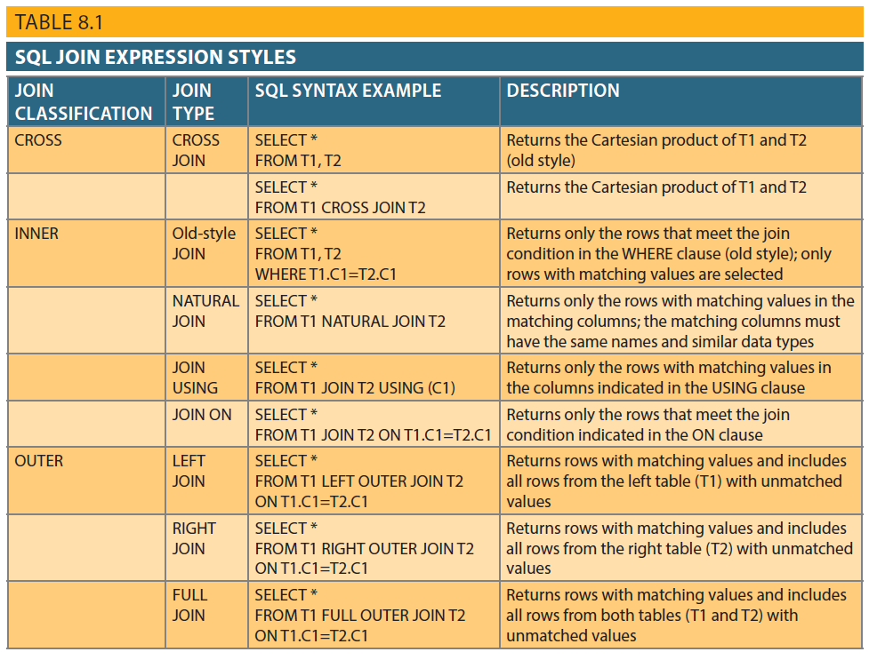
Table 8.1 - SQL Join Expression Styles
Copyright © 2017 Cengage Learning
4

Slide 5
Outer Joins
OUTER JOINS
SELECT P_CODE, VENDOR.V_CODE, V_NAME
FROM VENDOR LEFT JOIN PRODUCT ON VENDOR.V_CODE = PRODUCT.V_CODE;
RIGHT OUTER JOIN
SELECT P_CODE, VENDOR.V_CODE, V_NAME
FROM VENDOR RIGHT JOIN PRODUCT ON VENDOR.V_CODE = PRODUCT.V_CODE;
FULL OUTER JOIN
SELECT P_CODE, VENDOR.V_CODE, V_NAME
FROM VENDOR FULL JOIN PRODUCT ON VENDOR.V_CODE = PRODUCT.V_CODE;
Copyright © 2017 Cengage Learning
5

Slide 6
Cross and Natural Join
CROSS JOINS (PRODUCT)
SELECT * FROM INVOICE CROSS JOIN LINE;
SELECT INVOICE.INV_NUMBER, CUS_CODE, INV_DATE, P_CODE
FROM INVOICE CROSS JOIN LINE;
SELECT INVOICE.INV_NUMBER, CUS_CODE, INV_DATE, P_CODE
FROM INVOICE, LINE;
NATURAL JOIN
SELECT CUS_CODE, CUS_LNAME, INV_NUMBER, INV_DATE
FROM CUSTOMER NATURAL JOIN INVOICE;
SELECT INV_NUMBER, P_CODE, P_DESCRIPT, LINE_UNITS, LINE_PRICE
FROM INVOICE NATURAL JOIN LINE NATURAL JOIN PRODUCT;
Copyright © 2017 Cengage Learning
6

Slide 7
Subqueries and Correlated Queries
Subquery is a query inside another query
Subquery can return:
One single value - One column and one row
A list of values - One column and multiple rows
A virtual table - Multicolumn, multirow set of values
No value - Output of the outer query might result in an error or a null empty set
Copyright © 2017 Cengage Learning
7

Slide 8
WHERE Sub-queries
Uses inner SELECT subquery on the right side of a WHERE comparison expression
Value generated by the subquery must be of a comparable data type
If the query returns more than a single value, the DBMS will generate an error
Can be used in combination with joins
Copyright © 2017 Cengage Learning
8

Slide 9
Where Sub-queries
: LIST ALL VENDORS THAT PROVIDE PRODUCTS?
SELECT V_CODE, V_NAME FROM VENDOR
WHERE V_CODE IN (SELECT V_CODE FROM PRODUCT);
: LIST OF PRODUCTS WITH PRICE >= AVERAGE PRODUCT PRICE?
SELECT P_CODE, P_PRICE FROM PRODUCT
WHERE P_PRICE >= (SELECT AVG(P_PRICE) FROM PRODUCT);
Copyright © 2017 Cengage Learning
9

Slide 10
IN and HAVING Sub-queries
IN subqueries
Used to compare a single attribute to a list of values
HAVING subqueries
HAVING clause restricts the output of a GROUP BY query by applying conditional criteria to the grouped rows
Copyright © 2017 Cengage Learning
10

Slide 11
In Sub-queries
: LIST ALL CUSTOMERS WHO ORDERED THE PRODUCT "CLAW HAMMER"?
SELECT DISTINCT CUS_CODE, CUS_LNAME, CUS_FNAME
FROM CUSTOMER
JOIN INVOICE USING (CUS_CODE)
JOIN LINE USING (INV_NUMBER)
JOIN PRODUCT USING (P_CODE)
WHERE P_CODE IN (SELECT P_CODE FROM PRODUCT WHERE P_DESCRIPT = 'Claw hammer');
: ALTERNATIVE SYNTAX
SELECT DISTINCT CUS_CODE, CUS_LNAME, CUS_FNAME
FROM CUSTOMER
JOIN INVOICE USING (CUS_CODE)
JOIN LINE USING (INV_NUMBER)
JOIN PRODUCT USING (P_CODE)
WHERE P_DESCRIPT = 'Claw hammer';
Copyright © 2017 Cengage Learning
11

Slide 12
In Sub-queries
: LIST ALL CUSTOMERS WHO ORDERED THE PRODUCT "CLAW HAMMER"?
SELECT DISTINCT CUS_CODE, CUS_LNAME, CUS_FNAME
FROM CUSTOMER
JOIN INVOICE USING (CUS_CODE)
JOIN LINE USING (INV_NUMBER)
JOIN PRODUCT USING (P_CODE)
WHERE P_CODE IN (SELECT P_CODE FROM PRODUCT WHERE P_DESCRIPT = 'Claw hammer');
: ALTERNATIVE SYNTAX
SELECT DISTINCT CUS_CODE, CUS_LNAME, CUS_FNAME
FROM CUSTOMER
JOIN INVOICE USING (CUS_CODE)
JOIN LINE USING (INV_NUMBER)
JOIN PRODUCT USING (P_CODE)
WHERE P_DESCRIPT = 'Claw hammer';
Copyright © 2017 Cengage Learning
12

Slide 13
Having Sub-queries
SELECT P_CODE, SUM(LINE_UNITS)
FROM LINE
GROUP BY P_CODE
HAVING SUM(LINE_UNITS) > (SELECT AVG(LINE_UNITS) FROM LINE);
Copyright © 2017 Cengage Learning
13

Slide 14
Multirow Subquery Operators: ANY and ALL
ALL operator
Allows comparison of a single value with a list of values returned by the first subquery
Uses a comparison operator other than equals
ANY operator
Allows comparison of a single value to a list of values and selects only the rows for which the value is greater than or less than any value in the list
Copyright © 2017 Cengage Learning
14

Slide 15
Multi-row Sub-queries
: LIST ALL PRODUCTS WITH A PRODUCT COST GREATER THAN ALL INDIVIDUAL PRODUCT COSTS OF PRODUCTS PROVIDED BY VENDORS IN FLORIDA?
SELECT P_CODE, P_QOH*P_PRICE
FROM PRODUCT
WHERE P_QOH*P_PRICE > ALL
(SELECT P_QOH*P_PRICE FROM PRODUCT
WHERE V_CODE IN (SELECT V_CODE FROM VENDOR WHERE V_STATE = 'FL'));
Copyright © 2017 Cengage Learning
15

Slide 16
FROM Sub-queries
FROM clause:
Specifies the tables from which the data will be drawn
Can use SELECT subquery
: LIST ALL CUSTOMER WHO PURCHASED PRODUCTS 13-Q2/P2 AND 23109-HB?
SELECT DISTINCT CUSTOMER.CUS_CODE, CUSTOMER.CUS_LNAME
FROM CUSTOMER,
(SELECT INVOICE.CUS_CODE FROM INVOICE NATURAL
JOIN LINE WHERE P_CODE = '13-Q2/P2') CP1,
(SELECT INVOICE.CUS_CODE FROM INVOICE NATURAL
JOIN LINE WHERE P_CODE = '23109-HB') CP2
WHERE CUSTOMER.CUS_CODE = CP1.CUS_CODE AND
CP1.CUS_CODE = CP2.CUS_CODE;
Copyright © 2017 Cengage Learning
16

Slide 17
Attribute List Sub-queries
SELECT statement uses attribute list to indicate what columns to project in the resulting set
Inline subquery
Subquery expression included in the attribute list that must return one value
Column alias cannot be used in attribute list computation if alias is defined in the same attribute list
Copyright © 2017 Cengage Learning
17

Slide 18
Attribute List Sub-queries
: List the difference between each product’s price and average product price
SELECT P_CODE,
P_PRICE,
(SELECT AVG(P_PRICE) FROM PRODUCT) AS AVGPRICE,
P_PRICE-(SELECT AVG(P_PRICE) FROM PRODUCT) AS DIFF
FROM PRODUCT;
: List the product code, total sales by product, and contribution by employee of each product sales?
SELECT P_CODE,
SUM(LINE_UNITS*LINE_PRICE) AS SALES,
(SELECT COUNT(*) FROM EMPLOYEE) AS ECOUNT,
SUM(LINE_UNITS*LINE_PRICE) /
(SELECT COUNT(*) FROM EMPLOYEE) AS CONTRIB
FROM LINE
GROUP BY P_CODE;
Copyright © 2017 Cengage Learning
18

Slide 19
Correlated Sub-query
Executes once for each row in the outer query
Inner query references a column of the outer subquery
Can be used with the EXISTS special operator
Copyright © 2017 Cengage Learning
19

Slide 20
Correlated Sub-queries
: List all product sales for which the units sold is greater than the average units sold for that product
SELECT INV_NUMBER, P_CODE, LINE_UNITS
FROM LINE LS
WHERE LS.LINE_UNITS >
(SELECT AVG(LINE_UNITS)
FROM LINE LA
WHERE LA.P_CODE = LS.P_CODE);
: Add a correlated in-line sub-query to list the average units sold per product
SELECT INV_NUMBER, P_CODE, LINE_UNITS,
(SELECT AVG(LINE_UNITS) FROM LINE LX WHERE LX.P_CODE = LS.P_CODE) AS AVG
FROM LINE LS
WHERE LS.LINE_UNITS >
( SELECT AVG(LINE_UNITS)
FROM LINE LA
WHERE LA.P_CODE = LS.P_CODE);
Copyright © 2017 Cengage Learning
20

Slide 21
Summary
SQL is a robust language with many features
Operations that join tables are the most common in database systems
Inner joins and outer joins are both used in industry
Sub-queries and correlated queries process data based on other processed data
Most sub-queries are executed in serial fashion
Copyright © 2017 Cengage Learning
21

Slide 22
Task
Explain the role of the sub-queries in the following statement.
SELECT P_CODE,
SUM(LINE_UNITS*LINE_PRICE) AS SALES,
(SELECT COUNT(*) FROM EMPLOYEE) AS ECOUNT,
SUM(LINE_UNITS*LINE_PRICE) /
(SELECT COUNT(*) FROM EMPLOYEE) AS CONTRIB
FROM LINE
GROUP BY P_CODE;
Copyright © 2017 Cengage Learning
22

